Slide 1
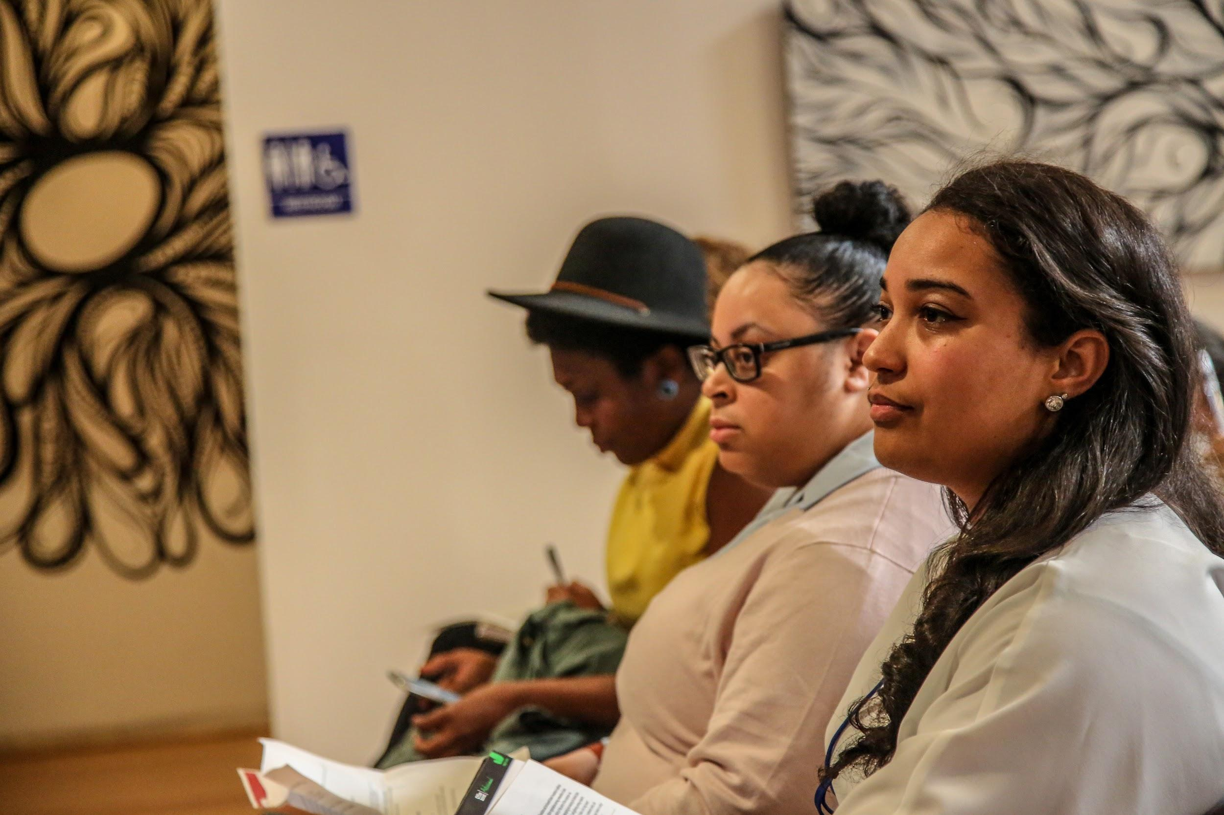
CRN Equity in Evaluation Session 03 Equity & Evaluation Practice in
Cultural Organizations

Slide 2
What is the Landscape of Philanthropic Funding?
Arts Funding in the Context of GDP
Point 1: Private foundations in the U.S. collectively hold about $800 billion in assets.
Point 2: Most large, endowed private foundations pay out at or slightly above 5% of required payout level.
Notes:
Throughout the 20th century, large US institutional foundations such as the multiple Carnegie foundations, the Ford Foundation, and The Rockefeller Foundation played an outsize role in philanthropy. By virtue of their large share of the philanthropic marketplace, these institutions were able to shape the thinking of policymakers, attract social innovators, and exert influence to bring together the private sector, government, and civil society. As a result, they played a vital role in underwriting social change: They helped to eradicate polio in the United States and then across most of the world; they provided 96% of Americans with easy access to free libraries; they helped to reduce smoking in the United States by more than 60 percent; and they promoted a “green revolution” that dramatically increased agricultural production.¹

Slide 3
What is the Landscape of Racial Equity in Arts Funding?
Finding 1: Arts foundations and nonprofit leaders are increasingly aware of diversity, equity, and inclusion issues in the nonprofit cultural sector.
Finding 2: But, despite these efforts, funding is getting less equitable.
Source: “Not Just Money: Where is the Money Going?,” Helicon Collaborative, 2017
Source: “Not Just Money: Where is the Money Going?,” Helicon Collaborative, 2017
Notes:
Finding #1: Arts foundations and nonprofit leaders are increasingly aware of diversity, equity and inclusion issues in the nonprofit cultural sector.
Finding #2: But despite these efforts, funding is getting less equitable.

Slide 4
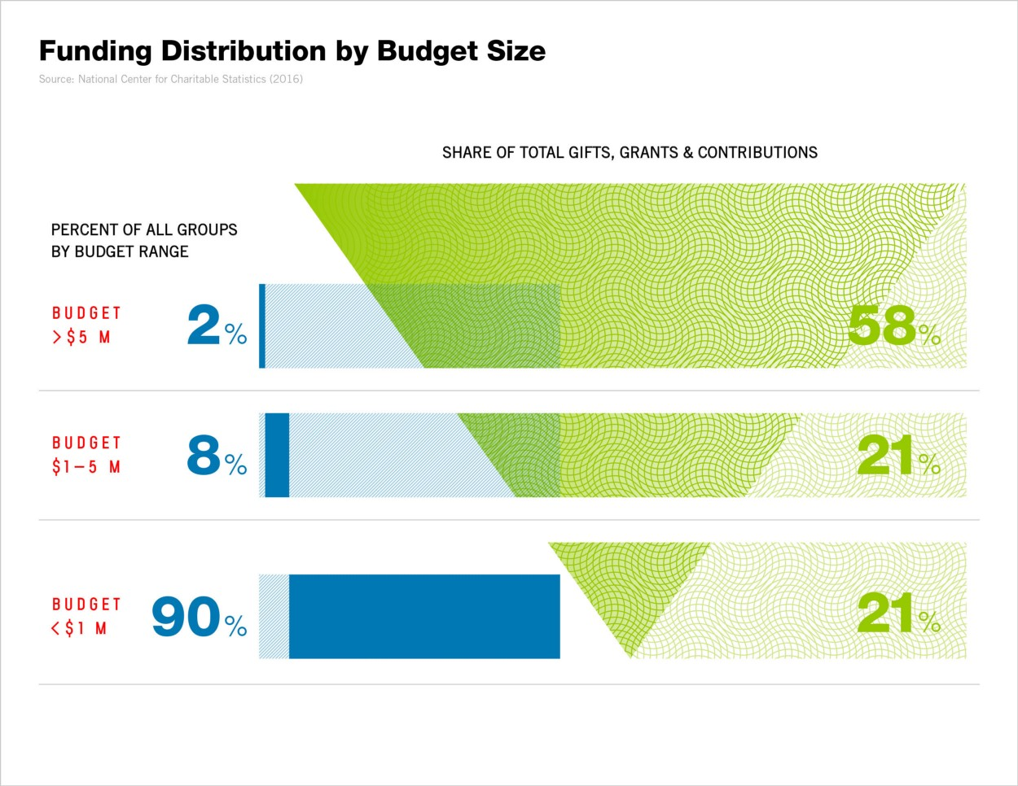
What is the Landscape of Racial Equity in Arts Funding?
Source: “Not Just Money: Where is the Money Going?,” Helicon Collaborative, 2017
“As the portion of funding to the largest institutions has increased, the portion to smaller groups has declined.”
Notes:
Finding #1: Arts foundations and nonprofit leaders are increasingly aware of diversity, equity and inclusion issues in the nonprofit cultural sector.
Finding #2: But despite these efforts, funding is getting less equitable.

Slide 5
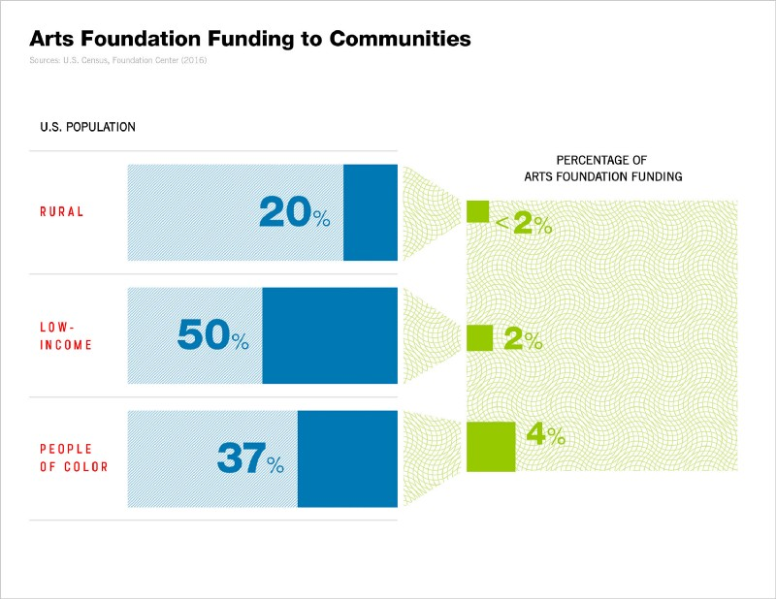
What is the Landscape of Racial Equity in Arts Funding?
Source: “Not Just Money: Where is the Money Going?,” Helicon Collaborative, 2017
“People of color represent 37% of the population, but just 4% of all foundation arts funding is allocated to groups whose primary mission is to serve communities of color.”
Notes:
Finding #1: Arts foundations and nonprofit leaders are increasingly aware of diversity, equity and inclusion issues in the nonprofit cultural sector.
Finding #2: But despite these efforts, funding is getting less equitable.

Slide 6
What is the Landscape of Racial Equity in Arts Funding?
Finding 3: The inequities are systemic, and local funding patterns mirror national ones.
Finding 4: San Francisco shows that sustained and systemic efforts can make a difference.
Source: “Not Just Money: Where is the Money Going?,” Helicon Collaborative, 2017
Source: “Not Just Money: Where is the Money Going?,” Helicon Collaborative, 2017
Notes:
Finding #3: The inequities are systemic, and local funding patterns mirror national ones.
Finding #4: San Francisco shows that sustained and systemic efforts can make a difference.
In San Francisco, approximately 32% of cultural groups have primary missions to serve communities of color, low-income communities, LGBTQ populations and disabled communities, and approximately 32% of arts foundation funding is allocated to such groups. (DataArts)

Slide 7
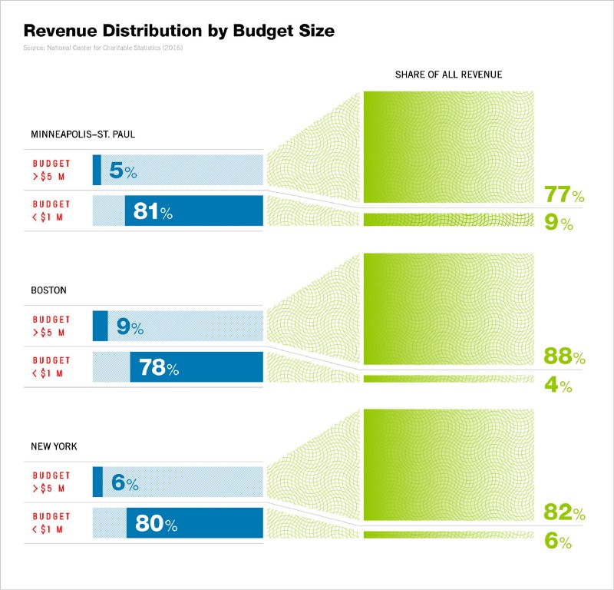
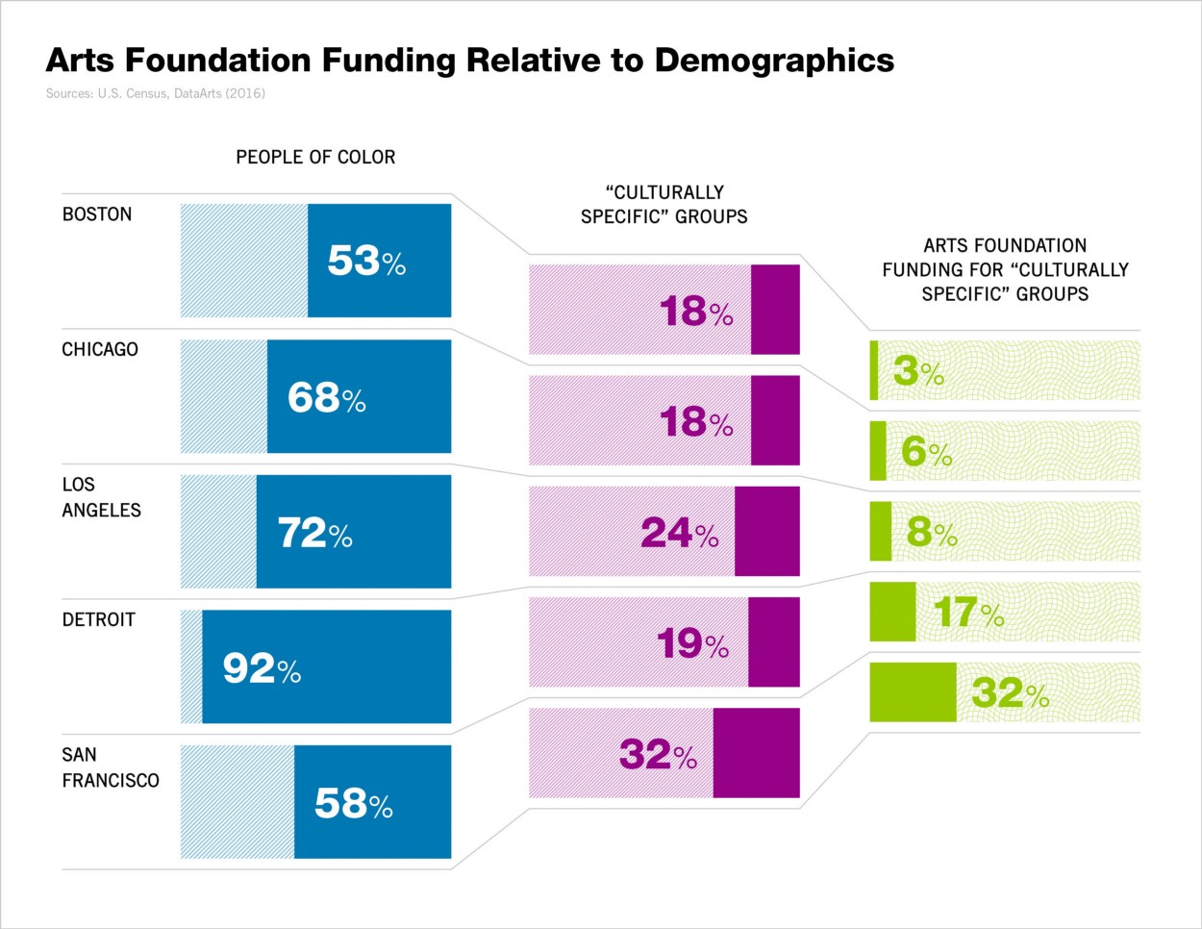
What is the Landscape of Racial Equity in Arts Funding?
Source: “Not Just Money: Where is the Money Going?,” Helicon Collaborative, 2017
Notes:
Finding #3: The inequities are systemic, and local funding patterns mirror national ones.
Finding #4: San Francisco shows that sustained and systemic efforts can make a difference.
In San Francisco, approximately 32 percent of cultural groups have primary missions to serve communities of color, low-income communities, LGBTQ populations and disabled communities, and approximately 32 percent of arts foundation funding is allocated to such groups. (DataArts)

Slide 8
What is the Landscape of Racial Equity in Arts Funding?
Arts Funding in the Context of Race
Increasing awareness of diversity, equity, and inclusion issues
2% of all cultural institutions receive nearly 60% of foundation giving in the arts
Inequality up 5% from a decade ago
33% of U.S. residents are people of color
4% of cultural philanthropy goes to organizations of color
Source: “Not Just Money: Equity Issues in Arts Philanthropy”, Helicon Collaborative, 2017
Notes:
In 2008, GIA began our own racial equity, racial justice journey both internally and for the field, with board and staff leadership.
As talk of “DEI” increases, funding to communities of color decreases:
Arts foundations and nonprofit leaders are increasingly aware of diversity, equity and inclusion issues in the nonprofit sector.
Despite this, 2% of all cultural institutions receive nearly 60% of foundation giving in the arts, up 5% from a decade ago.
In a country where 33% of residents are people of color, just 4% of cultural philanthropy goes to organizations of color.

Slide 9
What is the Landscape of Racial Equity in COVID-Era Arts Funding?
In late 2020, GIA shared findings from a survey of our members that revealed that arts grantmakers were increasing their giving, their flexibility, and support for BIPOC artists and organizations in response to the pandemic and the Movement for Black Lives.
In 2020, arts grantmakers changed their giving practices in the following ways:
Source: “Arts Grantmakers’ Changes in Practice: Present and future”, Grantmakers in the Arts, 2020
57% reported increasing their giving in 2020
28% increased their giving by 30% or more
69% increased their number of grantees
30% gave about the same
13% gave less
41% reported increasing their giving in support of anti-racism
51% reported giving to more BIPOC-led organizations
61% will increase giving to BIPOC organizations & artists in the near future
65% will increase giving to BIPOC organization & artists as standard practice going forward
Notes:
In late 2020, GIA shared findings from a survey of our members that revealed that arts grantmakers were increasing their giving, their flexibility, and support for BIPOC artists and organizations in response to the pandemic and movement for Black lives.
The patterns revealed in 2020’s survey of arts and culture grantmaking were similar to patterns in the broader grantmaking field. The grantmaking field had become increasingly flexible as part of being increasingly supportive. But the larger grantmaking field have said they did not plan to stay this flexible indefinitely.
A year later, we have conducted a follow-up survey to see if increased support, flexibility, and equity have continued. We are delighted to find that these changes in practice have continued, but we are deeply worried about some projections for the future.
To put this data in the broader context, in 2020 – despite individual and foundations’ philanthropic giving hitting record highs – in the aggregate, individual and philanthropic giving to arts, culture and humanities declined. In contrast, GIA’s members have increased their giving.
In 2020, nearly half of GIA members surveyed said they would increase their giving in the near future
In 2021, half of GIA members surveyed said they had increased their giving and said they would increase their giving in the near future
In 2020, 13% said they would give 30% more or higher in the near future
In 2021, 37% said they had increased their giving by 30% or more
In 2021, 10% said they would increase their giving by 30% or more in the near future

Slide 10
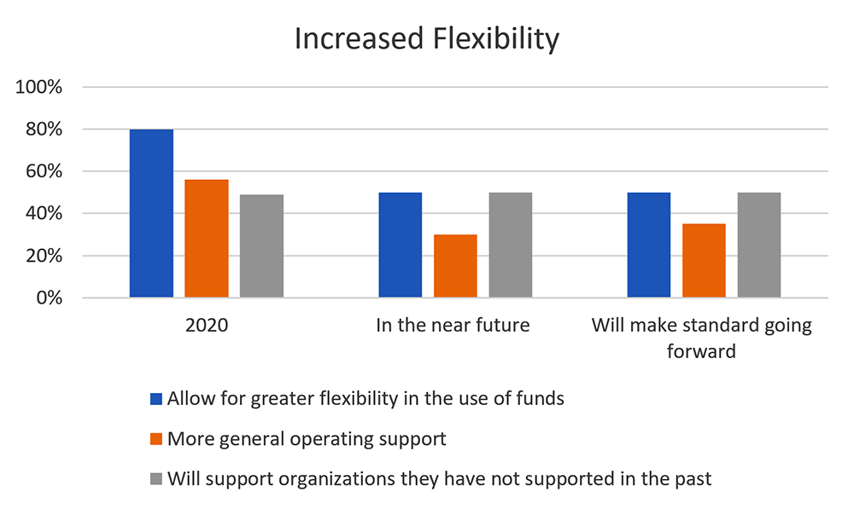
What is the Landscape of Racial Equity in COVID-Era Arts Funding?
Source: “Arts Grantmakers’ Changes in Practice: Present and future”, Grantmakers in the Arts, 2020
In 2020, GIA-member arts grantmakers changed their giving practices in the following ways:
Notes:
In late 2020, GIA shared findings from a survey of our members that revealed that arts grantmakers were increasing their giving, their flexibility, and support for BIPOC artists and organizations in response to the pandemic and movement for Black lives.
The patterns revealed in 2020’s survey of arts and culture grantmaking were similar to patterns in the broader grantmaking field. The grantmaking field had become increasingly flexible as part of being increasingly supportive. But the larger grantmaking field have said they did not plan to stay this flexible indefinitely.
A year later, we have conducted a follow-up survey to see if increased support, flexibility, and equity have continued. We are delighted to find that these changes in practice have continued, but we are deeply worried about some projections for the future.
To put this data in the broader context, in 2020 – despite individual and foundations’ philanthropic giving hitting record highs – in the aggregate, individual and philanthropic giving to arts, culture and humanities declined. In contrast, GIA’s members have increased their giving.

Slide 11
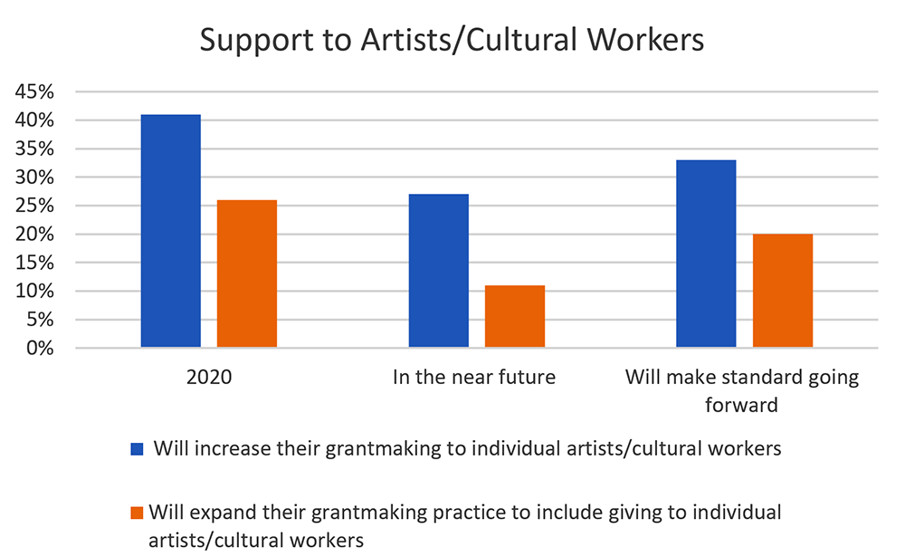
What is the Landscape of Racial Equity in COVID-Era Arts Funding?
Source: “Arts Grantmakers’ Changes in Practice: Present and future”, Grantmakers in the Arts, 2020
In 2020, GIA-member arts grantmakers changed their giving practices in the following ways:
Notes:
In late 2020, GIA shared findings from a survey of our members that revealed that arts grantmakers were increasing their giving, their flexibility, and support for BIPOC artists and organizations in response to the pandemic and movement for Black lives.
The patterns revealed in 2020’s survey of arts and culture grantmaking were similar to patterns in the broader grantmaking field. The grantmaking field had become increasingly flexible as part of being increasingly supportive. But the larger grantmaking field have said they did not plan to stay this flexible indefinitely.
A year later, we have conducted a follow-up survey to see if increased support, flexibility, and equity have continued. We are delighted to find that these changes in practice have continued, but we are deeply worried about some projections for the future.
To put this data in the broader context, in 2020 – despite individual and foundations’ philanthropic giving hitting record highs – in the aggregate, individual and philanthropic giving to arts, culture and humanities declined. In contrast, GIA’s members have increased their giving.

Slide 12
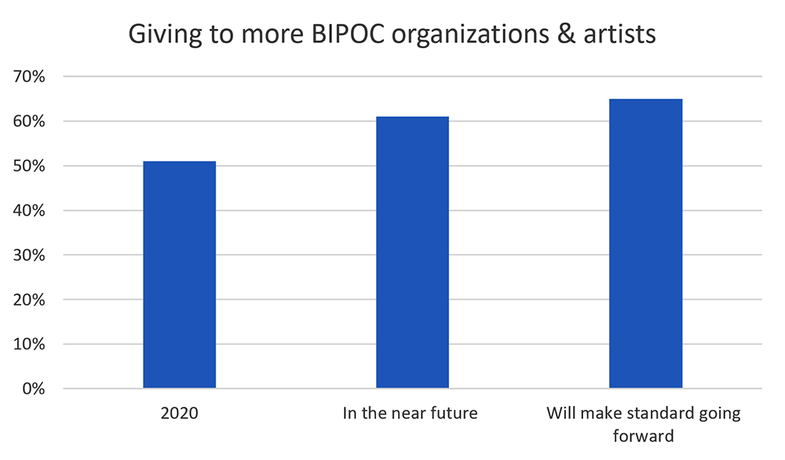
What is the Landscape of Racial Equity in COVID-Era Arts Funding?
Source: “Arts Grantmakers’ Changes in Practice: Present and future”, Grantmakers in the Arts, 2020
In 2020, GIA-member arts grantmakers changed their giving practices in the following ways:
Notes:
In late 2020, GIA shared findings from a survey of our members that revealed that arts grantmakers were increasing their giving, their flexibility, and support for BIPOC artists and organizations in response to the pandemic and movement for Black lives.
The patterns revealed in 2020’s survey of arts and culture grantmaking were similar to patterns in the broader grantmaking field. The grantmaking field had become increasingly flexible as part of being increasingly supportive. But the larger grantmaking field have said they did not plan to stay this flexible indefinitely.
A year later, we have conducted a follow-up survey to see if increased support, flexibility, and equity have continued. We are delighted to find that these changes in practice have continued, but we are deeply worried about some projections for the future.
To put this data in the broader context, in 2020 – despite individual and foundations’ philanthropic giving hitting record highs – in the aggregate, individual and philanthropic giving to arts, culture and humanities declined. In contrast, GIA’s members have increased their giving.

